Slide 1

DIGITAL
REVOLUTION
Presentation By
DEEPIKA S
23EIR016

Slide 2

TOPICS
What do you mean by digital revolution?
What were the causes of the digital revolution?
What was the first digital revolution?
Examples

Slide 3

What do you mean by digital revolution?
The Digital Revolution (also known as the Third Industrial Revolution) is the shift from mechanical and analogue electronic technology to digital electronics, which began in the closing years of the 20th century.

Slide 4
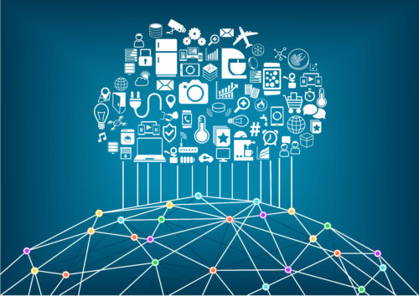
What were the causes of the digital revolution?
3 Factors That Led to The Digital Revolution
Digitization of information. According to history, the need to leave a digital footprint contributed to the revolution.
Increases and changes in consumer demands. The advent of the computer set the digital revolution in motion.
Invention and introduction of the world wide web.

Slide 5
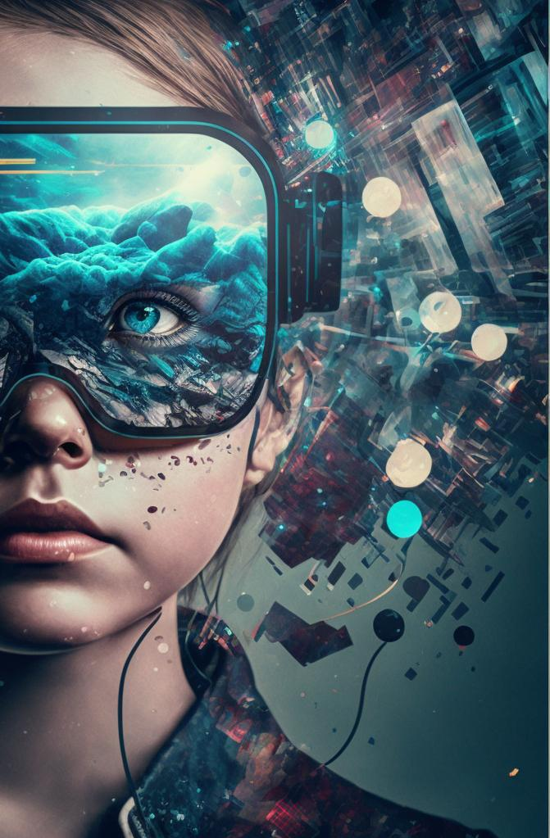
What was the first digital revolution?
The starting point of the digital revolution is considered to be: a) the invention of the computing system called Electronic Numerical Integrator and Calculator (ENIAC) between 1943-1946. b) in 1969, when the first computers were connected over the ARPANET (Advanced Research Projects Agency Network).

Slide 6
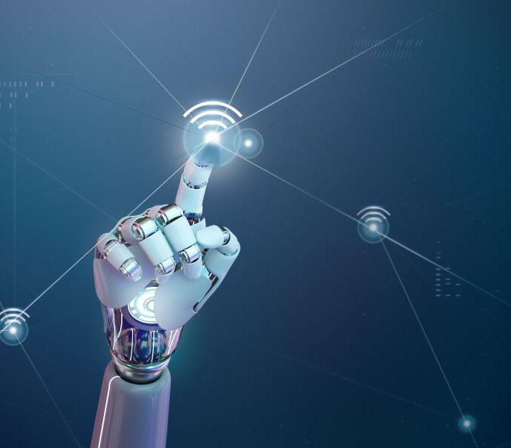
Examples Of Digital Revolution
Personal computers,
the internet,
the World Wide Web,
smartphones,
social media,
cloud computing,
artificial intelligence,
and the Internet of Things (IoT)

Slide 7
ADVANTAGES
Accessibility to information,
easy and immediate communication
ability to share information,
new jobs,
increased commercial competition

Slide 8
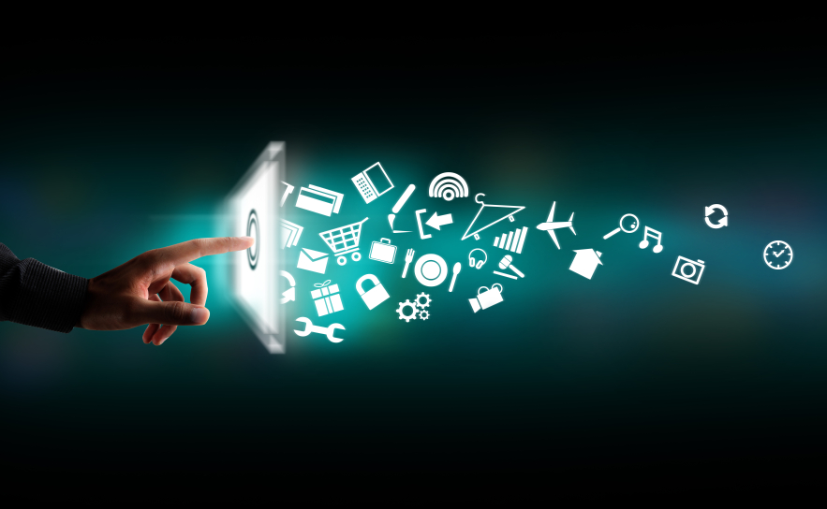
Disadvantage of Digital Revolution
Security Risk
Addiction
Privacy Concern
Job Displacement

Slide 9


